Slide 1
Name: V. RAMESH KUMAR
NM id: au730321104039
Reg. No: 730321104039
Year: III
Department: B.E Computer science and Engineering
College Name: Builders Engineering College
3/21/2024
Annual Review
1

Slide 2
PROJECT TITLE
LANGUAGE TRANSLATION
3/21/2024
Annual Review
2

Slide 3

1. Introduction to language translation.
2. Technologies and Tools.
3. Hardware Requirements.
4. Software Development
5. Algorithm.
6. Use Cases and Applications.
7. Conclusion.
AGENDA
3/21/2024
Annual Review
3

Slide 4

PROBLEM STATEMENT
The task is to develop a Recurrent Neural Network (RNN) model for language translation. Given a sequence of words in one language (source language), the model is required to predict the corresponding sequence of words in another language (target language). This task involves training the RNN to learn the mapping between the source and target languages, enabling it to accurately translate text from one language to another.
Key Challenges:
1. Sequence-to-Sequence Learning
2. Dataset
3. Model Architecture
3/21/2024
Annual Review
4

Slide 5

PROJECT OVERVIEW
Accurate language translation model capable of translating text from a source language to a target language.
OpenCV to perform text detection and extraction from images or videos.
Use OpenCV to display the translated text on the screen or overlay it onto the original image or video.
Libraries such as NLTK or spaCy.
Potential areas for future work include exploring advanced architectures such as Transformer models.
3/21/2024
Annual Review
5

Slide 6

WHO ARE THE END USERS?
1. Individuals
2. Government Agencies
3. Educational Institutions
4. Nonprofit Organizations
5. Legal Industry
3/21/2024
Annual Review
6

Slide 7

YOUR SOLUTION AND ITS VALUE PROPOSITION
Solution:
Benefit from large-scale pre-training on diverse text corpora, achieve state-of-the-art performance.
Value Proposition:
Create value by enabling communication, fostering understanding, and facilitating collaboration in an increasingly interconnected and multicultural world.
3/21/2024
Annual Review
7

Slide 8

THE WOW IN YOUR SOLUTION
1. Accuracy
2. Speed
3. Fluency
4. Context Awareness
5. Multilingual Support
3/21/2024
Annual Review
8

Slide 9
MODELLING
Modeling refers to the process of building computational models that can automatically translate text from one language to another.
Fine-Tuning and Hyperparameter Tuning
Post-Processing
Inference
Data Preprocessing
Training
3/21/2024
Annual Review
9

Slide 10
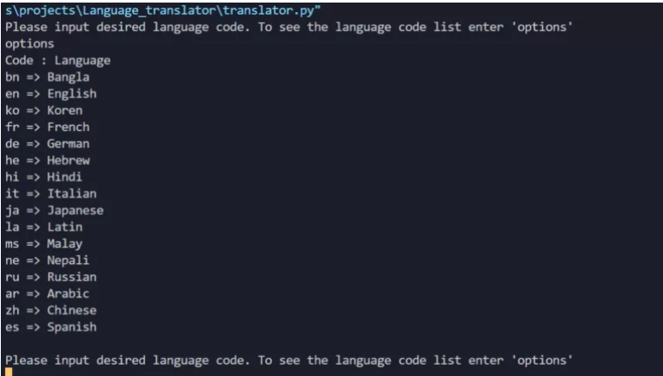
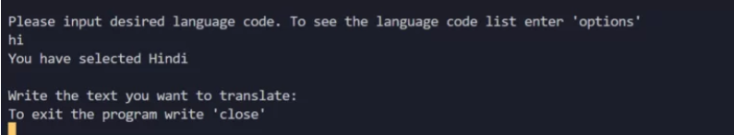
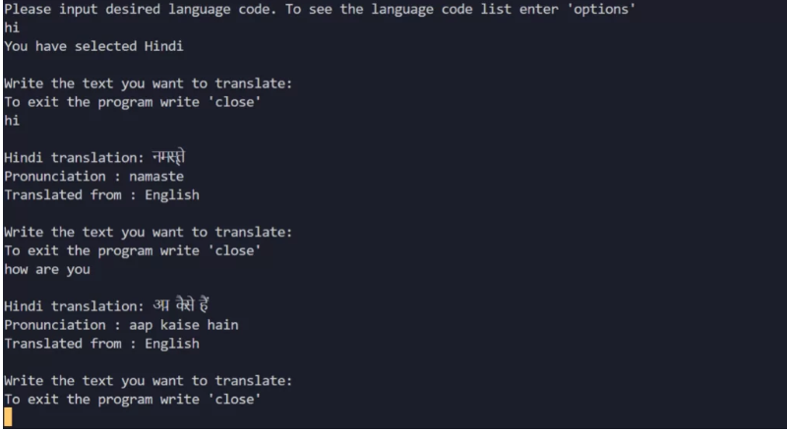
RESULTS
3/21/2024
Annual Review

